Slide 1
Message Passing Interface

Slide 2
Parallel Programming
Parallel programming developed as a means of improving performance and efficiency.
In a parallel program, the processing is broken up into parts, each of which can be executed concurrently.
The instructions from each part run simultaneously on different CPUs. These CPUs can exist on a single machine, or they can be CPUs in a set of computers connected via a network.
Notes:
https://youtu.be/c0C9mQaxsD4?list=TLPQMjkwMzIwMjIJGOskpvQOFw
Neso academy

Slide 3
What is MPI?
Message Passing Interface (MPI) is a standardized and portable message-passing system to function on a wide variety of parallel computers.
It is an API for communication between nodes of a distributed memory parallel computer (typically, now, a workstation cluster).
It is an API for sending and receiving messages. But it goes further than this.

Slide 4
MPI for Java
The original standard defines bindings to C and Fortran
Then a lot of wrappers have been released for java such as: mpiJava, MPJ, MPJ Express, …

Slide 5
Getting Started with MPJ Express
1. Download MPJ Express from
https://sourceforge.net/projects/mpjexpress/files/releases/
2. Follow the installation steps mentioned in the following link
http://mpj-express.org/docs/readme/README-win.txt
3. Write your MPJ Express program (HelloWorld.java) and save it.
4. Compile: javac -cp .;%MPJ_HOME%/lib/mpj.jar HelloWorld.java
5. Execute: mpjrun.bat -np 4 HelloWorld
If you don’t have a quad core, use -np 2, if the 2 processes running in your world has the same rank, this means that they don’t see the same world, we recommend that you do this work on linux if you face this problem, in the lab folder you’ll find a linuxguide.pdf for MPJ Express
Notes:
Download Eclipse from here: https://www.eclipse.org/downloads/download.php?file=/oomph/epp/2021-03/R/eclipse-inst-jre-win64.exe

Slide 6
Configuration steps
1- Add environment variable
MPJ_HOME to the pathtoMPJfolder “mpjv0-44”
2- in your IDE, in run configuration Add vm options as following:
-jar “/pathtoMPJfolder/lib/starter.jar” -np 2
3- Add mpj.jar to your project

Slide 7
Important functions in MPI
MPI.Init()
MPI.Finalize()
MPI.COMM_WORLD.Rank()
MPI.COMM_WORLD.Size()
MPI.COMM_WORLD.Send()
MPI.COMM_WORLD.Recv()

Slide 8
Init() and finalize()
MPI.Init(String[] args)
Initializes the MPI execution environment.
This routine must be called before any other MPI routine is called.
MPI can be initialized at most once.
MPI.Finalize()
Terminates MPI execution environment.
This routine cleans up all MPI states.
Once this routine is called, no MPI routine (not even Init) may be called,

Slide 9
Rank() and Size()
COMM_WORLD:
In MPI, the “initial” communicator is a communicator spanning all the processes in which the SPMD program was started.
This communicator is accessed as a static field of the MPI class
int MPI.COMM_WORLD.Rank()
Determines the rank of the calling process in group of communication.
int MPI.COMM_WORLD.Size()
Returns the size of the group associated with a communicator.
Notes:
SPMD (single program, multiple data) is a technique employed to achieve parallelism

Slide 10
Point to Point Communication Routines

Slide 11
MPI.COMM_WORLD.Send()
Request Send(java.lang.Object buf, int offset, int count, Datatype datatype, int dest, int tag)
Buf receive buffer array
Offset initial index in receive buffer
Count number of items in receive buffer
Datatype datatype of each item in receive buffer
Dest rank of destination
Tag message tag
returns: communication request
Notes:
Available Datatypes: MPI.BYTE, MPI.CHAR, MPI.SHORT, MPI.BOOLEAN, MPI.INT, MPI.LONG, MPI.FLOAT, MPI.DOUBLE, MPI.OBJECT, MPI.LB, MPI.UB, MPI.PACKED

Slide 12
MPI.COMM_WORLD.Recv()
Request Recv(java.lang.Object buf, int offset, int count, Datatype datatype, int src, int tag)
Buf receive buffer array
Offset initial offset in receive buffer
Count number of items in receive buffer
Datatype datatype of each item in receive buffer
Src rank of source
Tag message tag
returns: communication request

Slide 13
Blocking / Non-Blocking methods
The Send and Recv operations are blocking which means
Send or receive complete on return, then buffers can be re-used
The Isend and Irecv operations are all non-blocking.
Check back for send or receive completion: Wait, Test, WaitAny, ...
Buffers cannot be re-used until completion

Slide 14
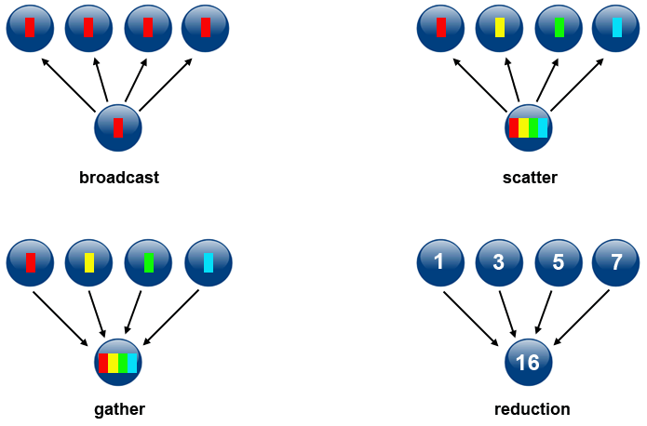
Collective Communication Routines
https://computing.llnl.gov/tutorials/mpi/

Slide 15
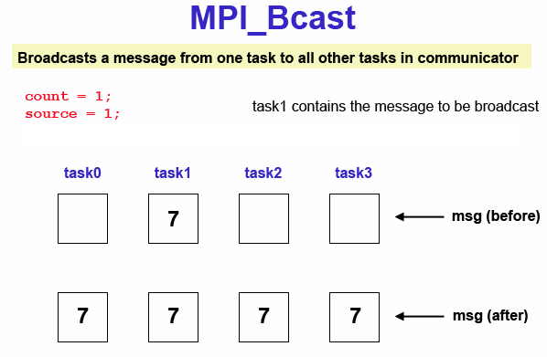

Slide 16
MPI.COMM_WORLD.Bcast()
Bcast(Object buffer, int offset, int count, Datatype datatype, int root)
buffer : buffer array
offset : initial offset in buffer
count : number of items in buffer
datatype: datatype of each item in buffer
root : rank of broadcasting root
It’s called by the broadcasting process and the receiving processes with the same arguments

Slide 17
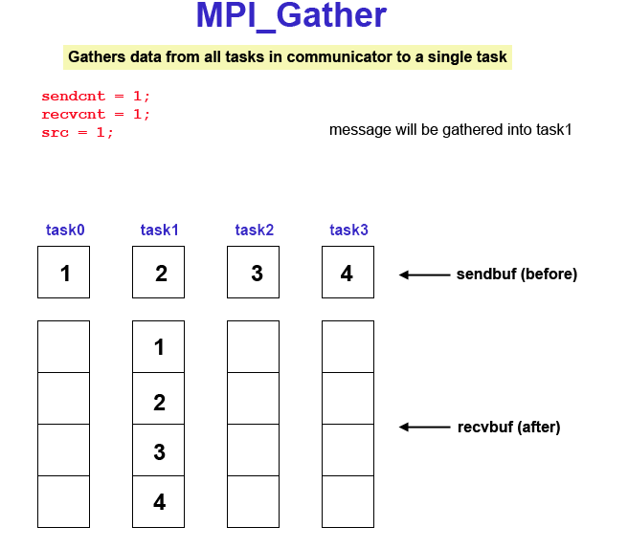

Slide 18
MPI.COMM_WORLD.Gather()
Gather(Object sendbuf, int sendoffset, int sendcount, Datatype sendtype, Object recvbuf, int recvoffset, int recvcount, Datatype recvtype, int root)
sendbuf: send buffer array
sendoffset: initial offset in send buffer
sendcount: number of items to send
sendtype: datatype of each item in send buffer
recvbuf: receive buffer array
recvoffset: initial offset in receive buffer

Slide 19
MPI.COMM_WORLD.Gather()
recvcount: number of items in receive buffer
recvtype: datatype of each item in receive buffer
root: rank of receiving process
All processes send the same amount of information
Use Gatherv if the amount of information differs per process
It’s called by the processes that send information and the receiving root process with the same arguments
The root process also sends information

Slide 20
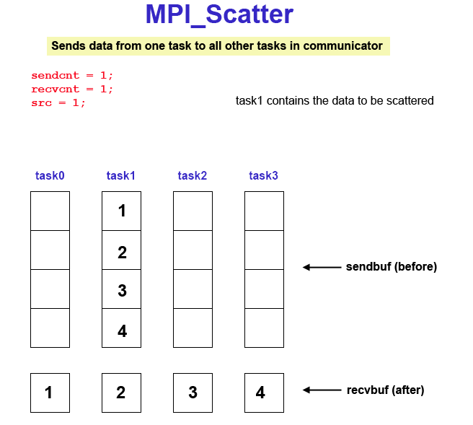

Slide 21
MPI.COMM_WORLD.Scatter()
Scatter(Object sendbuf, int sendoffset,int sendcount, Datatype sendtype, Object recvbuf, int recvoffset, int recvcount, Datatype recvtype, int root)
sendbuf: send buffer array
sendoffset: initial offset in send buffer
sendcount: number of items to send
sendtype: datatype of each item in send buffer
recvbuf: receive buffer array
recvoffset: initial o set in receive buffer

Slide 22
MPI.COMM_WORLD.Scatter()
recvcount: number of items in receive buffer
recvtype: datatype of each item in receive buffer
root: rank of sending process
All processes get the same amount of information
Use Scatterv if the amount of information differs per process
It’s called by the processes that receives information and the sending root process with the same arguments
The root process also receives information

Slide 23
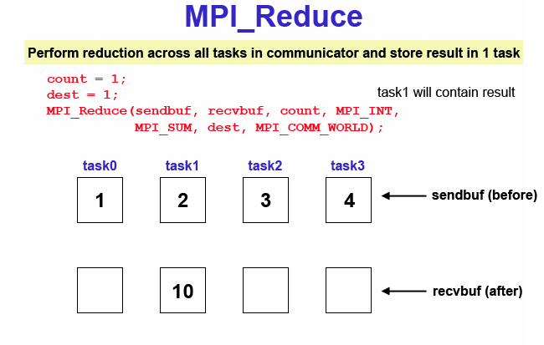

Slide 24
MPI.COMM_WORLD.Reduce()
Reduce(Object sendbuf, int sendoffset, Object recvbuf, int recvoffset, int count, Datatype datatype, Op op, int root)
Sendbuf: send buffer array
sendoffset: initial offset in send buffer
recvbuf: receive buffer array
recvoffset: initial o set in receive buffer
count: number of items in to recieve
type: datatype of each item
op : reduce operation
root: rank of sending process

